Slide 1
Knowledge Base Completion via Search-Based Question Answering
Date： | 2014/10/23
Author： | Robert West, Evgeniy Gabrilovich, Kevin Murphy, Shaohua Sun, Rahul Gupta, Dekang Lin
Source： | WWW’14
Advisor： | Jia-ling Koh
Speaker： | Sz-Han,Wang

Slide 2
Outline
Introduction
Method
Offline training
KB Completion
Experiment
Conclusion

Slide 3
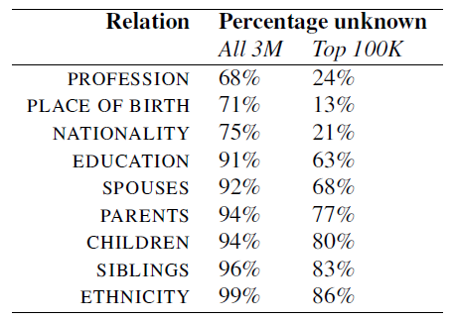
Introduction
Motivation
Large-scale knowledge bases (KBs)—e.g., Freebase , NELL , and YAGO — contain a wealth of valuable information, stored in the form of RDF triples (subject–relation–object)
Despite their size, these knowledge bases are still woefully incomplete in many ways
Incompleteness of Freebase for some relations that apply to entities of type PERSON

Slide 4
Introduction
Goal
Propose a way to leverage existing Web-search–based question-answering technology to fill in the gaps in knowledge bases in a targeted way
Problem
Which questions should issue to the QA system?
the birthplace of the musician Frank Zappa
where does Frank Zappa come from?
where was Frank Zappa born? → more effective
Frank Zappa’s mother
who is the mother of Frank Zappa? → “The Mothers of Invention”
who is the mother of Frank Zappa Baltimore? → “Rose Marie Colimore” → correct

Slide 5
Outline
Introduction
Method
Offline training
KB Completion
Experiment
Conclusion

Slide 6
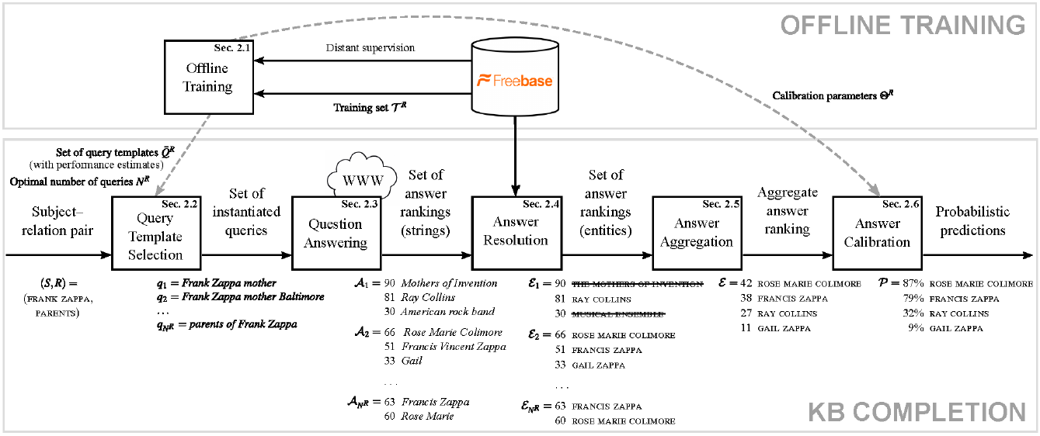
Framework
Input: subject-relation pairs (FRANK ZAPPA, PAERENTS)
Output: previously unknown object (ROSE MARIE COLMORE, …)
Query template:
___ mother
parents of ___

Slide 7


Offline training
Construct Query template : (lexicalization template , augmentation template)
Mining lexicalizations template from search logs
Count for each relation-template pair (R,$\overline{q}$)
( Relation , Template) | count
(PARENTS, _ mother) | 10
(PARENTS, parents of _) | 20
(PLACE OF BIRTHDAT, where is _ born) | 15
… | …
Named-entity recognition
Named-entity recognition
Query q: parents of Frank Zappa
Entity S: Frank Zappa
Replace q with a placeholder
Replace q with a placeholder
Template$\overline{q}$: parents of ___
Run QA system
→ get answer entity
Run QA system
→ get answer entity
Answer a: …Francis Zappa.
Entity A: Francis Zappa
Increase the count of ( R,$\overline{q}$)
Increase the count of ( R,$\overline{q}$)
(S,A) is linked by a relation R
R: PARENTS
(Parents, parents of _) +1

Slide 8
Offline training
Construct Query template : (lexicalization template , augmentation template)
Query augmentation
Attaching extra words to a query as query augmentation
Specify a property(relation) for which value to be substituted
Manual template screening
Select 10 lexicalization template from the top candidates found by the log-mining
Select 10 augmentation template from the relations pertaining to the subject type
Relation
PROFESSION | PARENTS
PLACE OF BIRTH | CHILDREN
NATIONALITY | SIBLINGS
EDUCATION | ETHNICITY
SPOUSES | [no augmentation]
Subject-relation pair:
(Frank Zappa, PARENTS)
Lexicalization template:
__________ mother
Augmentation template:
PLACE OF BIRTH → Baltimore
Query:
Frank Zappa mother Baltimore

Slide 9
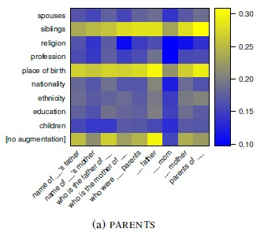
KB Completion Query Template Selection
Lexicalization template: 10
Augmentation template: 10
Strategy
Greedy (r = $∞$)
Random (r = 0)
Given a heatmap of query quality
Converting heatmap to a probability
distribution
Pr($\overline{q}$)$∝$exp ( r MRR($\overline{q}$) )
Sample without replacement
100 queries template
Dangers of asking too many queries !

Slide 10
KB Completion Question answering
Use an in-house QA system
Query analysis
Find the head phrase of the query
query: Frank Zappa mother
Web search
Retrieve the top n result snippet from the search engine

Slide 11
KB Completion Question answering
Snippet analysis:
Score each phrase in the result snippet
score(Rose Marie Colimore)=w1*f1+w2*f2+w3*f3+w4*f4+w5*f5+…
Phrase aggregation
Compute an aggregate score of each distinct phrase
score(Rose Marie Colimore)=w1*f1+w2*f2+w3*f3+…
Phrase | f1: ranked of snippet | f2: noun phrase | f3: IDF | f4: closed to the query term | f5: related to the head phrase | …
Rose Marie Colimore | 1 | 1 | 0.3 | 0.8 | 0.9
Phrase | f1: number of times the phrase appear | f2: average values | f3: maximum values | …
Rose Marie Colimore | 2 | (60+70)/2=75 | 70

Slide 12
KB Completion Answer resolution
Entity linking
Take into account the lexical context of each mention
Take into account other entities near the given mention
answer string : Gail → GAIL
context : Zappa married his wife Gail → GAIL ZAPPA
Discard incorrectly typed answer entities
Relation: PARENTS → Type: Person
Entity | Type
THE MOTHERS OF INVENTION X | Music
RAY COLLINS | Person
MUSICAL ENSEMBLE X | Music
….

Slide 13
KB Completion Answer resolution , Answer Calibration
Answer resolution: merge all of query answer ranking into a single ranking
Compute an entity’s aggregate score:
the mean of entity’s ranking-specific scores
$s\left(E\right)=\frac{1}{N^{R}}\sum_{i=1}^{N^{R}}{S_{i}(E)}$
Answer calibration: turn the scores into probabilities
Apply logistic regression
Entity: FRANCIS ZAPPA , $N^{R}$=4
$ε_{2}=$51
…
$ε_{4}=$49
score(FRANCIS ZAPPA )=(51+49)/4=25

Slide 14
Outline
Introduction
Method
Offline training
KB Completion
Experiment
Conclusion

Slide 15
Experiment
Training and Test Data
Type: PERSON
Relation: PROFESSION、PARENTS、PLACE OF BIRTH、CHILDREN、
NATIONALITY、SIBLINGS、EDUCATION、ETHNICITY、SPOUSES
100,000 most frequently searched for person
Divide into 100 percentiles and random sample 10 subjects per percentile
→ 1,000 subjects per relation
Ranking metric
MRR (mean reciprocal rank)
MAP (mean average precision)

Slide 16
Experiment
Quality of answer ranking
Quality of answer calibration

Slide 17
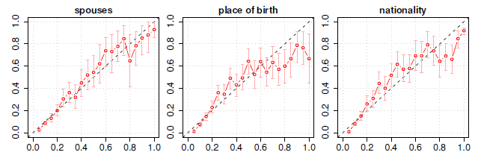
Experiment
Quality of answer calibration

Slide 18
Experiment
Number of high-quality answers

Slide 19
Outline
Introduction
Method
Offline training
KB Completion
Experiment
Conclusion

Slide 20
Conclusion
Presents a method for filling gaps in a knowledge base.
Uses a question-answering system, which in turn takes advantage of mature Web-search technology to retrieve relevant and up-to-date text passages to extract answer candidates from.
Show empirically that choosing the right queries—without choosing too many—is crucial.
For several relations, our system makes a large number of high-confidence predictions.

Slide 21
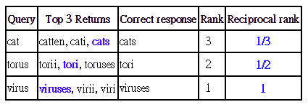
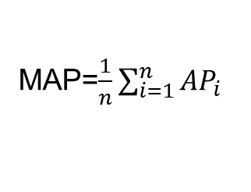
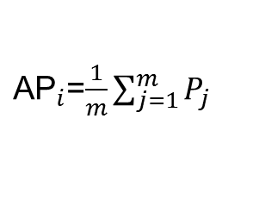
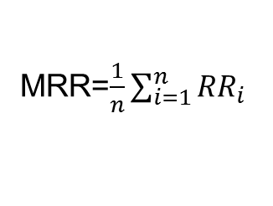
Ranking metric
MRR (mean reciprocal rank)
MAP (mean average precision)
${RR}_{i}$=$\frac{1}{r_{i}}$
MRR=$\frac{1}{n}\sum_{i=1}^{n}{{RR}_{i}}$
MMR=(1/3 + 1/2 + 1)/3 = 0.61
${\text{AP}}_{i}$=$\frac{1}{m}\sum_{j=1}^{m}{P_{j}}$
MAP=$\frac{1}{n}\sum_{i=1}^{n}{{AP}_{i}}$
MAP=(0.57 + 0.83 + 0.4)/3 = 0.6
Query | Average Precision
Q1 | 0.57
Q2 | 0.83
Q3 | 0.4

